Slide 1
Lab guidance for Azure SQL Database Managed Instance

Slide 2
Azure SQL Database Managed Instance labs
Introduction to SQL Managed Instance This lab demonstrates how to create an Azure SQL Database Managed Instance using the Azure Portal in a dedicated subnet of a virtual network. You will learn how to configure networks, security capabilities, and privacy capabilities of your Managed Instance. You will also understand how to size your MI, create disaster recovery protections, and manage & monitor security and performance tuning.
Migrate Using SQL Managed Instance This lab demonstrates how to migrate a SQL database to an Azure SQL Database Managed Instance using the Azure Database Migration Service.
SQL Managed Instance data integration and business intelligence Learn to control the seamless orchestration of your enterprises' data integration efforts through an extensive tour of Azure Data Factory.

Slide 3
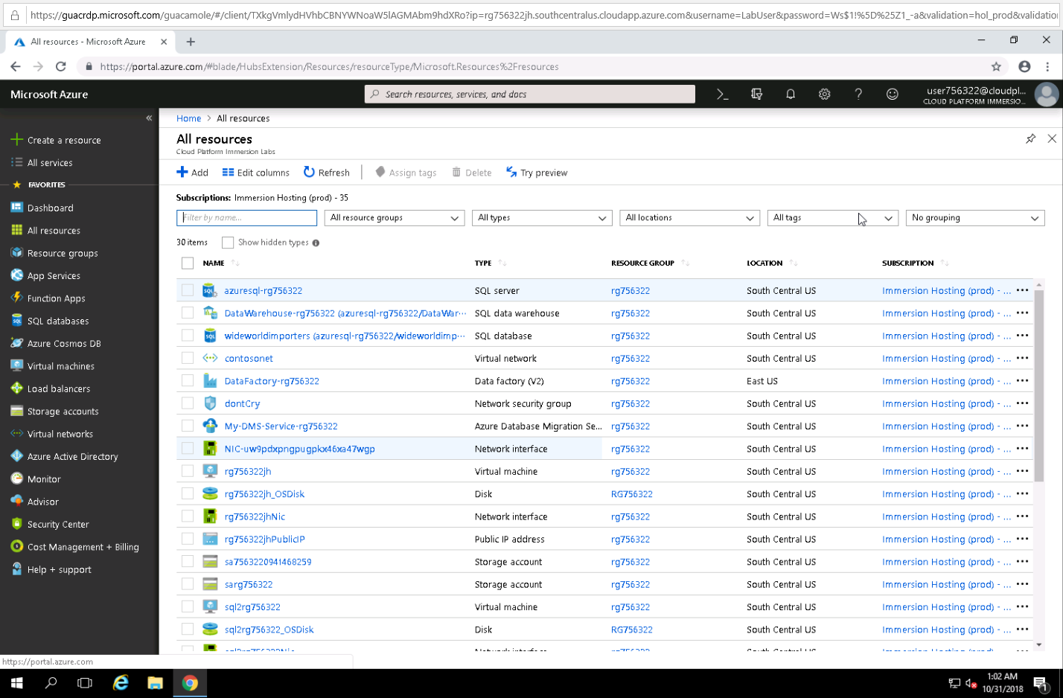
Prerequisites
Notes:
4 days notice is required for booking the Azure SQL Database Managed Instance labs
Limit in booking tool is 30 people. Add a note when booking to request an increase up to 100 if needed
It’s recommended to have 1 proctor for every 10-20 people taking these labs in a workshop style session
Book labs at: https://www.microsoft.com/handsonlabs/instructorledlabs

Slide 4
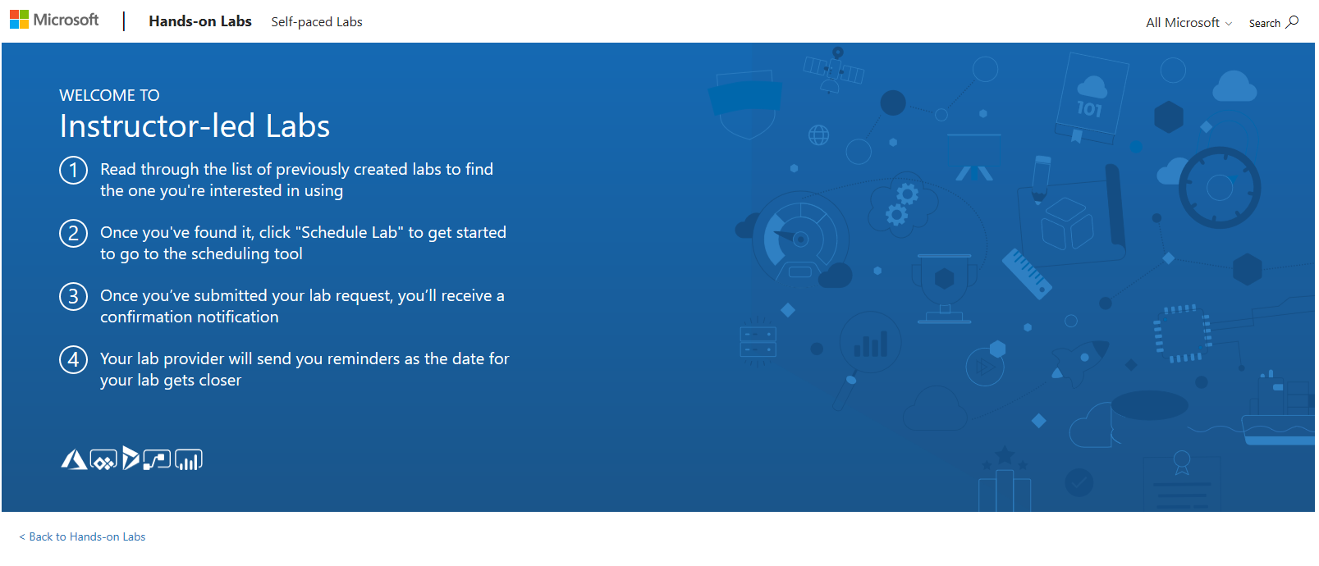
Booking labs
Got to https://www.microsoft.com/handsonlabs/instructorledlabs
Notes:
Note: You will need to book the labs for preparation and then again book the labs for the actual training delivery.
Labs must be booked 4 DAYS prior to accessing them.
Go to: https://www.microsoft.com/handsonlabs/instructorledlabs

Slide 5
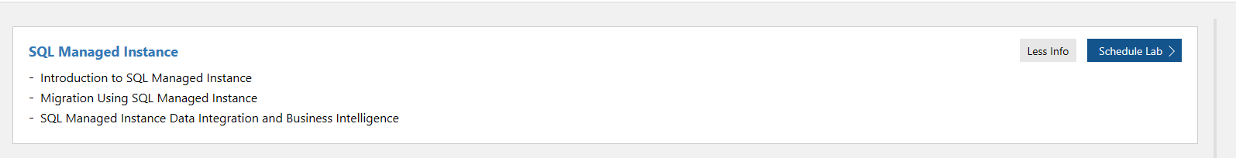
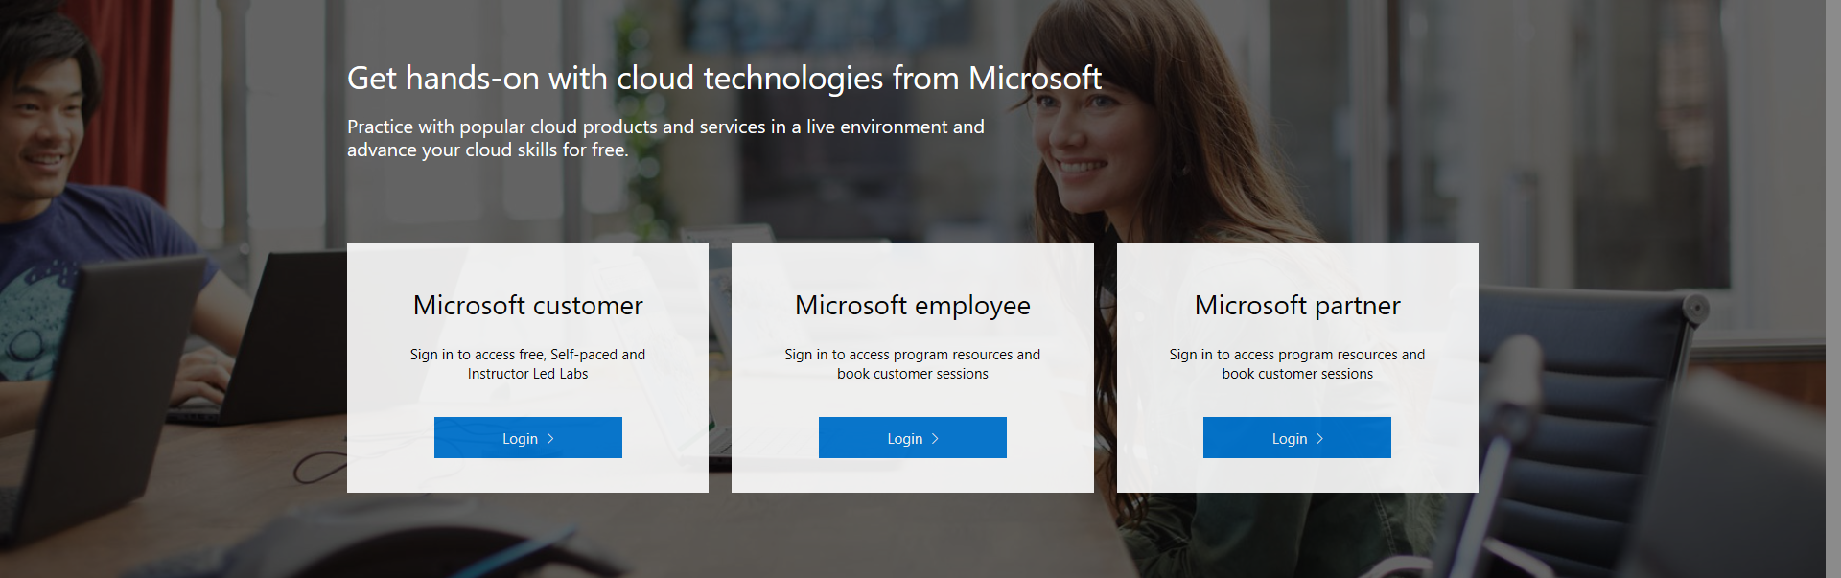
Login to the lab portal
Login to book labs
Note: Microsoft customers will need a Microsoft account.
Notes:
You will be routed to a page to log in using one of the following credentials:
Microsoft Customer
Microsoft Employee
Microsoft Partner
If you are not a Microsoft Employee or Partner, you will need to have your Microsoft contact book the labs for you.

Slide 6
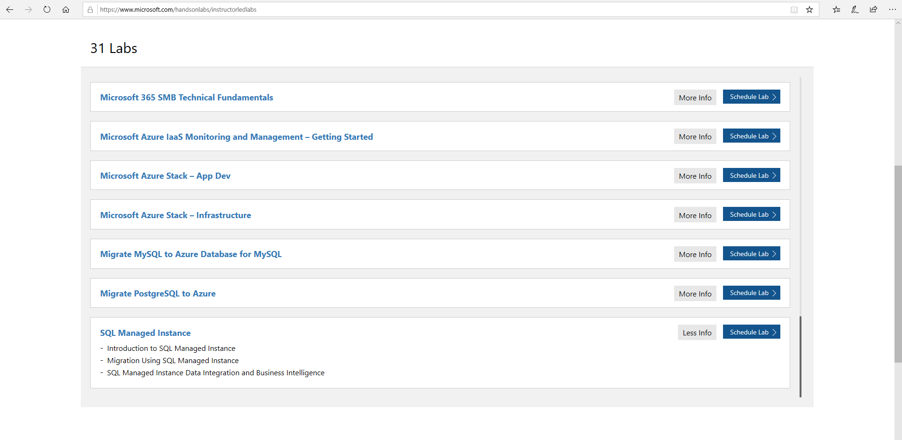
Schedule the SQL Managed Instance labs
Notes:
Select “SQL Managed Instance” from the list of instructor-led-labs

Slide 7
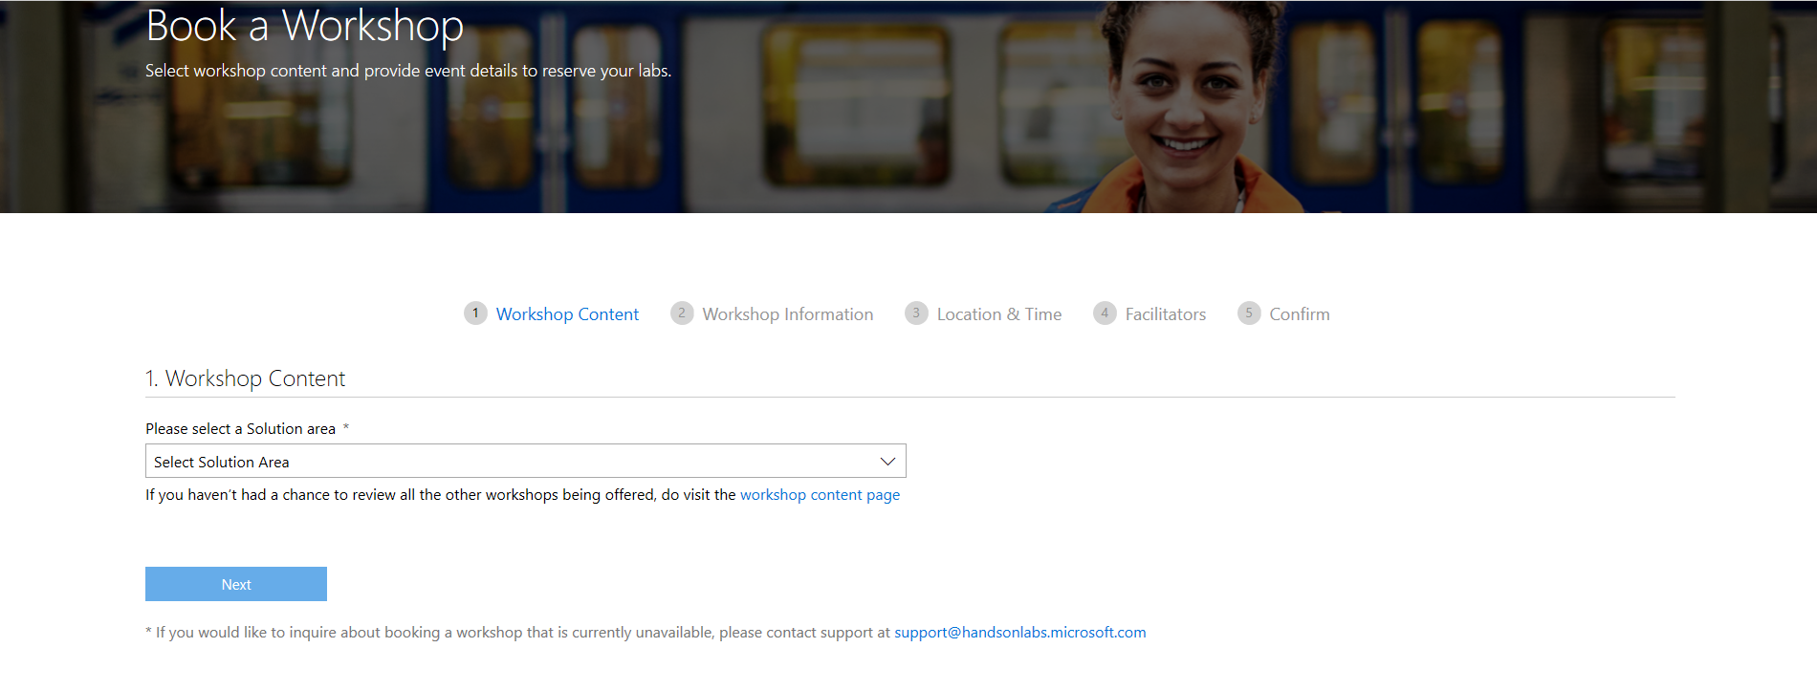
A group of labs for x number of people is a Workshop
Select “Data & AI”
There’s a bug that may not be fixed in all regions. If you don’t see “Managed Instance” select “Applications and Infrastructure”
Notes:
Under Workshop Content, select the “Data & AI” Solution Area
Click “Next”
Click on “Schedule an Instructor Led Workshop”
Find “SQL Managed Instance” and click “Schedule Lab”

Slide 8
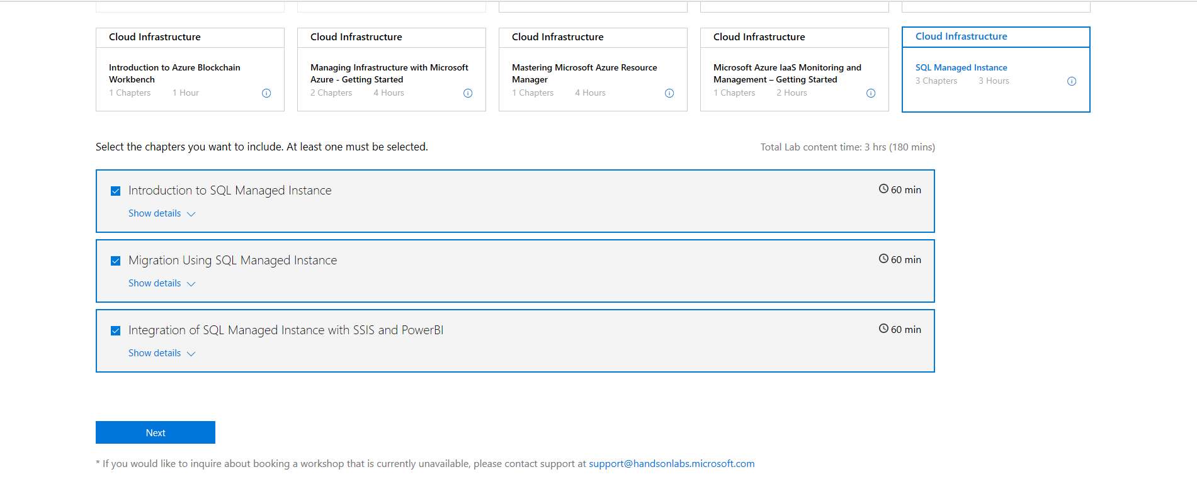
Select the labs you need for the workshop
Notes:
Under Data & AI, click “SQL Managed Instance” – the labs you will be using during your workshop are titled and are part of the track bundle:
Introduction to SQL Managed Instance
Migration using SQL Managed Instance
Integration of SQL Managed Instance with SSIS and Power BI
Click “Next”

Slide 9
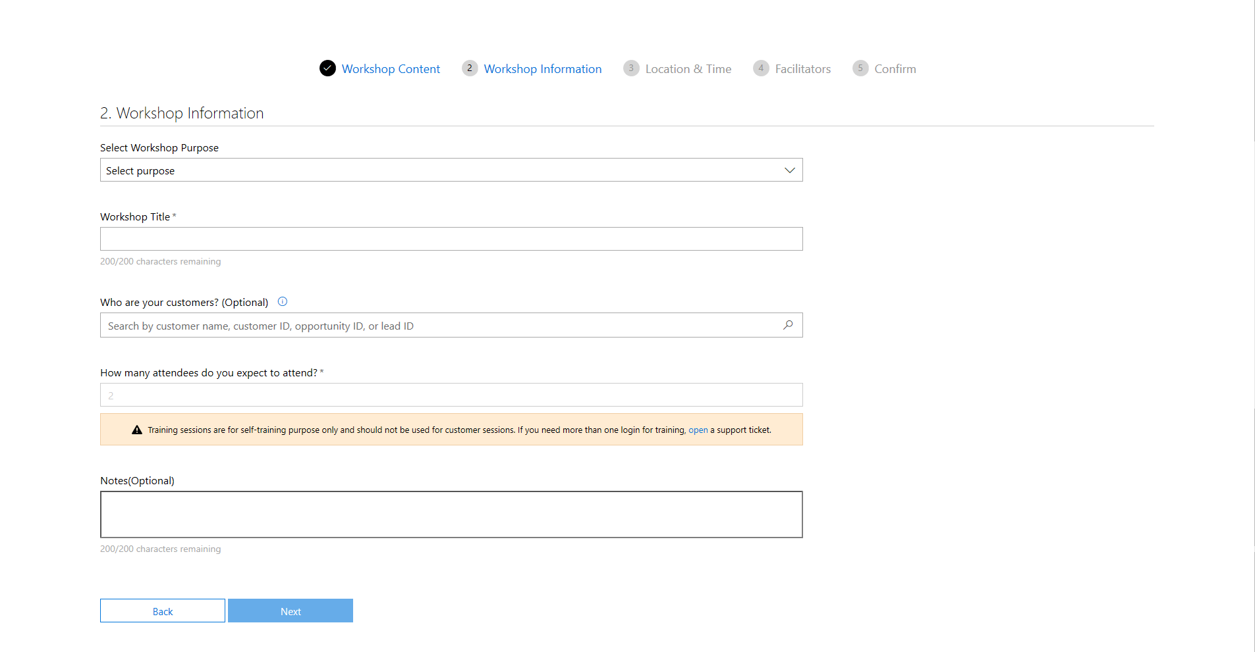
Fill out the workshop information
Notes:
Under Workshop Information
For access to the labs to prepare for your upcoming delivery please select “Personal Training Session” and enter in the title of your session – Azure SQL Managed Instance workshop preparation
For booking the actual partner delivery, please select “Other” and enter in the title of your session – Azure SQL Managed Instance partner/customer workshop.
Note: The default limit is 30 people. Add a note in the booking tool to request more people.
Click “Next”

Slide 10
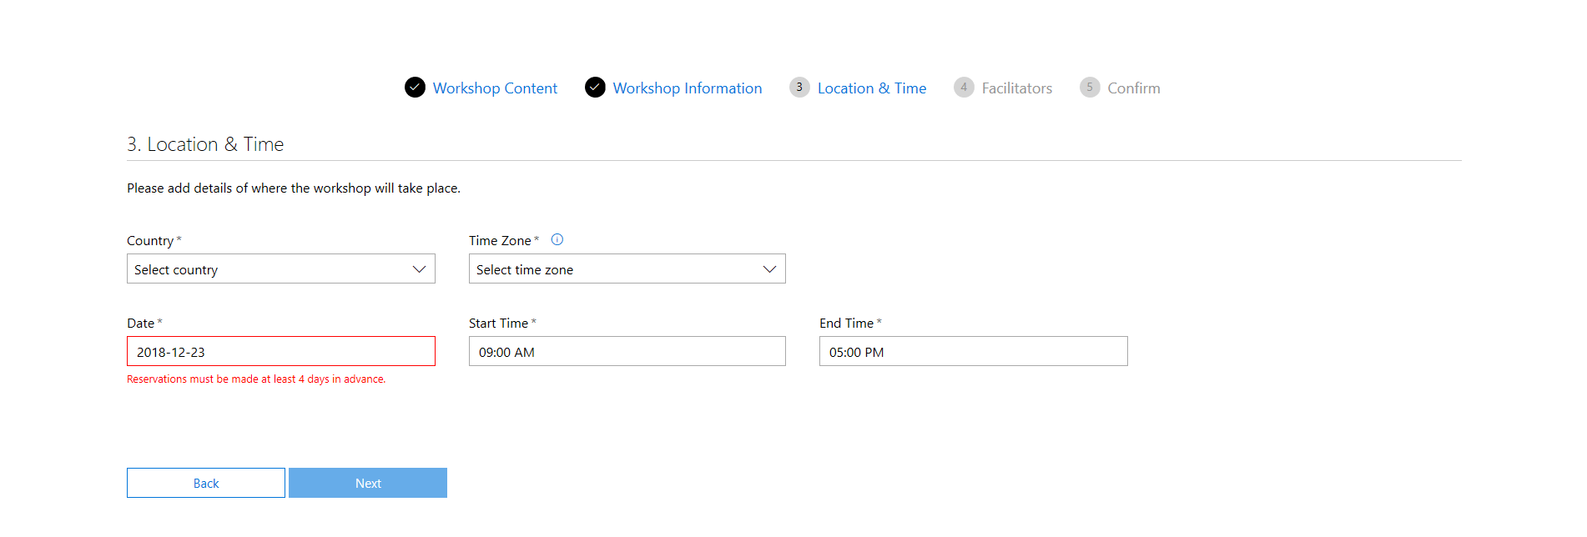
Fil in the location & time for workshop
Note: Reservations must be at least 4 days in advance
Notes:
Under Workshop Location & Time
Enter the country and time zone you will be delivering the labs
Enter the date. Note you need to book a min of 4 days in advance
Click “Next”

Slide 11
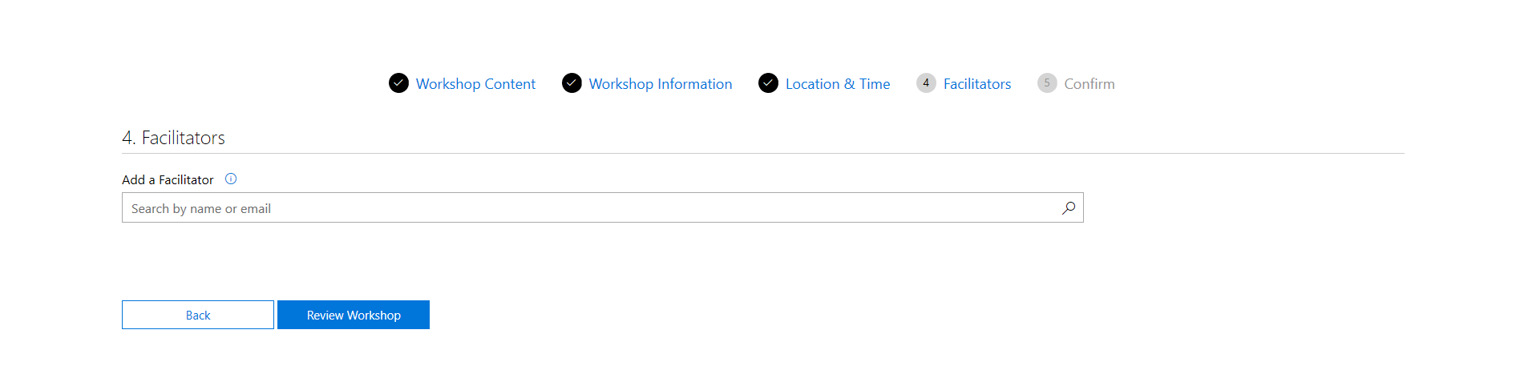
Add facilitators
Notes:
Under Facilitators
Enter at least one facilitator. They will be emailed a conformation and receive the lab URL when it’s ready to run.
Click “Next”

Slide 12
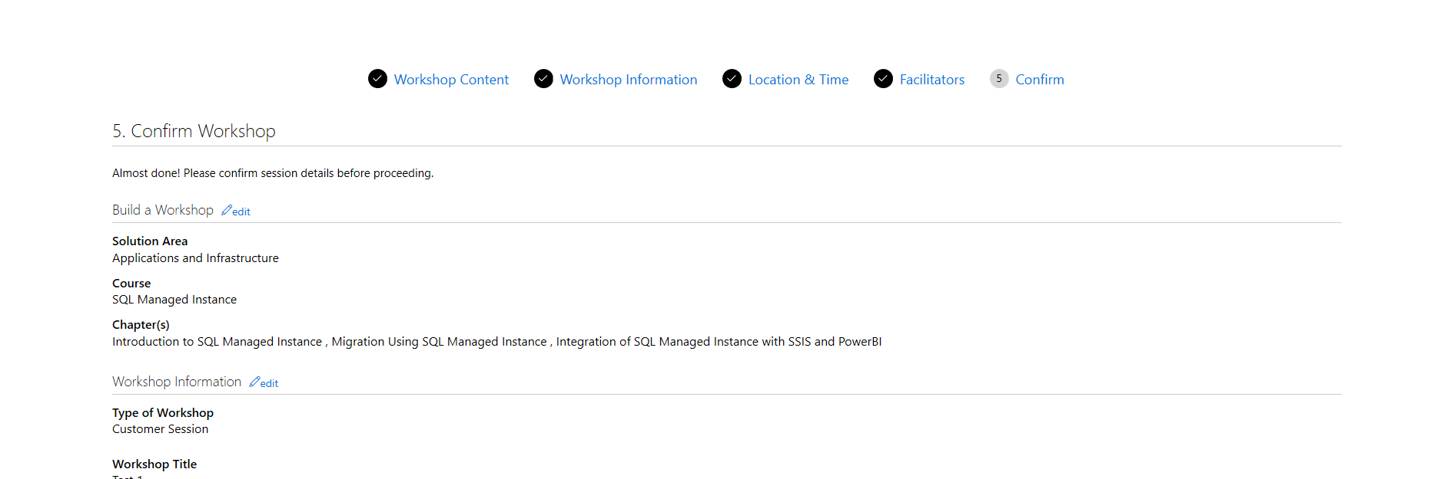
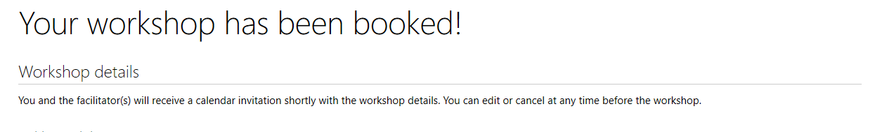
Review & book
Notes:
Under Conform
Review and book your workshop
The facilitator will receive a conformation email.

Slide 13
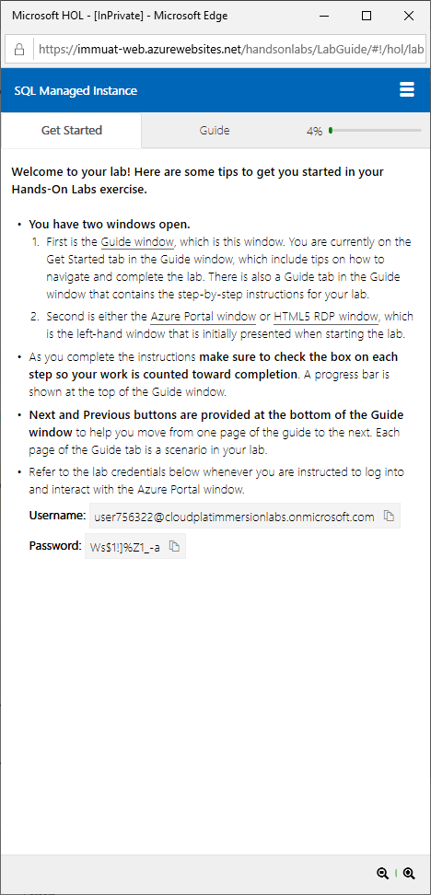
Running the labs in a Workshop
Once you’ve requested a workshop that includes labs you will get your own Tiny URL when the labs are ready. Normally 1 hours prior to start
Tiny URL: http://tinyurl.com/?????????
Make sure to login with the session credentials your give in the lab
Use an InPrivate browser
Notes:
The SQL MI labs have several browser pop-ups. One for the lab environment, one for the lab guide and in some cases one for an RDP session into a jump box.
Make sure participants have their browser pop-ups enabled
Double check the guide pop-up is sized correctly and not below the screen
For a better experience plan to have additional monitors and adaptors to connect people laptops to the monitors

Slide 14
Before each workshop session
Once booked, you will receive a calendar request for EACH of the sessions (one for preparation and one for partner delivery)
Please accept that invite for the session to be confirmed
If you have not received a calendar request within 7 days of your training, please email support@handsonlabs.microsoft.com
You will receive session login and password information for you and the students 1 hour before the session is scheduled to begin from Microsoft Hands on Labs (See appendix A for sample email), If you did not receive it, email the sessionsupport@handsonlabs.microsoft.com
Always walk through the scenarios before a session, even if you have facilitated the same content before as there are frequent updates to the content
If your attendees are bringing their own laptops, make sure they have 3rd party RDP client installed for mac OS or Linux

Slide 15
During each workshop session
Arrive at least 60 minutes before the session. Prepare and test the environment connection to ensure everything works properly
Write your session URL (tinyurl/xxxx), provided to you in the lab confirmation email, on a whiteboard so attendees can reference that during the sessions if they accidentally log out or have a hard time reading the demo script.
Call out instructor-only sections in the scenarios to prevent attendees from causing errors
Switch to click-through demos if you run into connectivity or system-related issues or if certain scenario is not working properly and switch back to the live hands-on labs for the next scenario
Administer the event evaluation form before the wrap-up session to ensure high response rate
In-session user support is available. Email sessionsupport@handsonlabs.microsoft.com

Slide 16
After each workshop session
Logins used in the session will be automatically disabled approximately one hour after your booked session
Share any feedback on successes and issues with the hands-on workshop experience, and report an issue by submitting a ticket on the field or partner portal
Support
Support provided by the Hands on Lab platform is Monday through Friday. If you require assistance over the weekend, the support team will not get back to you until Monday. Please try to plan ahead for preparing for the labs should you have questions that need to be addressed.
For general support questions or special workshop requests outside of the booking parameters, please contact the HOL General Support Team: support@handsonlabs.microsoft.com
If any issues are encountered during a live workshop and you require immediate assistance, please contact the HOL Session Support Team: sessionsupport@handsonlabs.microsoft.com

Slide 17
Blogs, best practices
Document | When to use it
Managed Instance ARM template reference Create SQL MI using ARM templates Change size of SQL MI using PowerShell | SQL MI management through ARM templates & PowerShell (official docs and blogs)
Cross-instance point-in-time restore in Azure SQL Database Managed Instance | How to restore database to another instance
CAT Blog: CPU and Memory Allocation on Azure SQL Database Managed Instance | Explains how to interpret various information exposed in SSMS and DMVs regarding resource allocation is SQL MI
CAT Blog: Storage best practices in General Purpose | In this article, we describe database storage architecture on Azure SQL Database Managed Instance (MI), for General Purpose (GP) instances specifically. We also provide a set of best practices to help optimize storage performance
CAT Blog: Consume SQL MI Error Log | How to filter out unnecessary info from SQL error log and focus on what's important to your app using sp_readmierrorlog
CAT Blog: Real time performance monitoring for Azure SQL DB Managed Instance | Configuring and suing Telegraf for real-time perf. monitoring in SQL Managed Instance
BLOG: How to send emails in SQL MI using DbMail
SCOM Management Pack for SQL MI | The blog announcement for SCOM MP for SQL MI and scope details

Slide 19
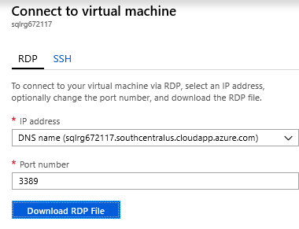
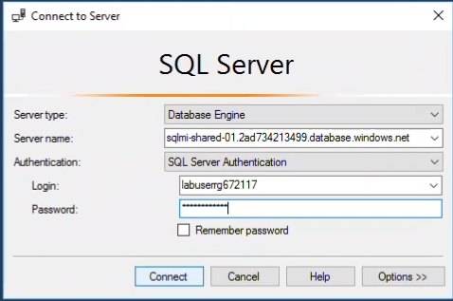
Connecting to Azure SQL DB Managed Instance via the VM in the lab
From Lab 2 – “Migration Using SQL Managed Instance”
RDP Username = labuser
RDP Password = Lab password
To connect to SQL MI use SSMS in the VM
SQL MI TEST = sqlmi-shared-01-test.568ebab56ce1.database.windows.net
SQL MI User = labuser + resource group name i.e. (labuserrg188393)
SQL MI password = Lab password (same as RDP password)

